Slide 1
The Exoplanet Mass-
Radius Relationship
Tayt Armitage, Bailey Stephens, Lauren Robinson, Caitlin O’Brien, Ethan Fahimi

Slide 2
Motivation
By knowing the mass and radius of a planet, conclusions about several of their properties
Observation methods can typically only find mass or radius at once
There is a need to find a relation between these properties

Slide 3
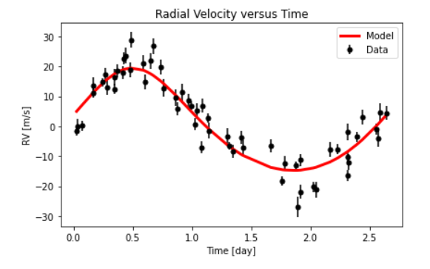
Methods | Calculating Mass
Mass was calculated using radial velocity data
From the plot shown, the semi-amplitude of the radial velocity can be found
Useful for finding the planet’s mass
Notes:
If short on time, describe radial velocity method
Measure shifts in the wavelength of a star’s light
Detect periodic, radial motion
Implies detection an exoplanet

Slide 4

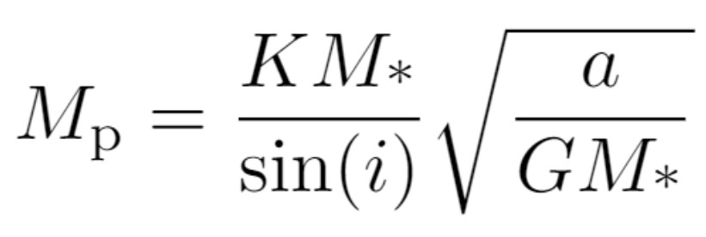
Methods | Calculating Mass (cont.)
To first order, the semi-amplitude of the radial velocity data gives the planet's mass
The following values were all pulled from the same paper (Butler et al., 2004)
K = 17.09 ± 0.22 m/s
M* = 0.441 ± 0.009 M_{sun}
i = 86.44 + 0.0.17 - 0.016 degrees
a = 0.0291 ± 0.0015 AU

Slide 5
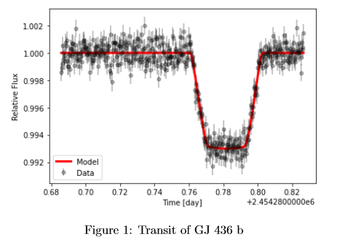
Methods | Calculating Radius
Used pylightcurve to generate a model of flux, plotted over transit data from Demming et al. 2007
Generated model values using NASA’s EXOFAST program
EXOFAST provides μ₁, μ_{2,} e R_{P}/R✶, P, a/R✶, ⍵, T_{mid} for modeling this data
Initial planetary and stellar data supplied by Maciejewski et al. 2014
Stellar temperature and metallicity data was supplied by Rosenthal et al. 2021
Notes:
the limb darkening coefficients,eccentricity, planet radius over stellar radius, period, semi-major axis to stellar radius ratio,inclination, periastron, and the mid time for our transit.

Slide 6

Methods | Calculating Radius (cont.)
The value of 𝛿 represents the depth of the transit
Uncertainty calculated as standard deviation of the points within the “dip”
Using 𝛿 we can calculate exoplanet’s radius
The radius of the star GJ 436 reported by Rosenthal et al. 2021

Slide 7
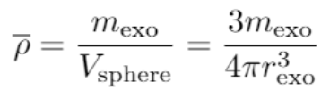
Methods | Calculating Density
Exoplanet is approximately spherical
Average density is simple to calculate
We can use calculated mass and radius
Density is not constant in GJ 436 b
Understanding structure of hot Neptune will help analyze our calculated density

Slide 8
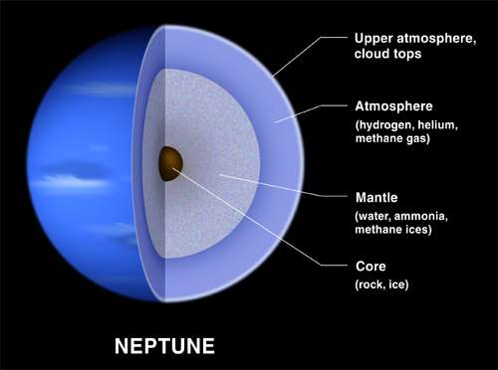
Methods | Calculating Density (cont.)
GJ 436 b is a hot Neptune
Hot Neptunes have three distinct sections
Rocky core
Large mantle
Gaseous atmosphere

Slide 9

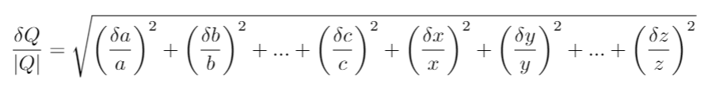
Method | Uncertainty Propagation
Product / Quotient Propagation:

Slide 10




Method | Uncertainty Propagation (cont…)
Trig Error Propagation:
Power Rule:

Slide 11
Results | GJ 436 b’s Mass and Radius
Our Calculated Mass: 21.7 ± 0.6 M_{Earth}
Reported Value: 22.1 ± 2.3 M_{Earth} (Maciejewski et al. 2014)
Our Calculated Radius: 0.339 ± 0.015 R_{Jupiter}
Reported Value: 0.372 ± 0.015 R_{Jupiter} (Maciejewski et al. 2014)
Calculated radii for GJ 436 b’s star has dropped since 2014
Results in variations of GJ 436 b’s calculated radius

Slide 12
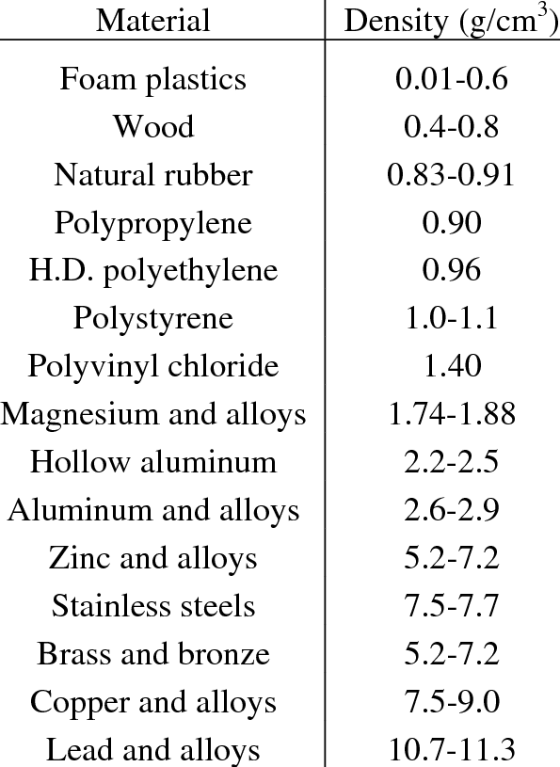
Results | Density
Our Calculated Density: 2.3 ± 0.2 g/cm³
Implies slightly rocky composition
Structure of gas giant implies a denser core
More likely in the “alloys” range
(Bell et al., 2003)

Slide 13
Results | Similar Exoplanets
Exoplanets within 50% GJ 436 b’s mass and radius
Calculated mean density of each exoplanet
Exoplanets missing mass / radius measurement were excluded
Missing values could be estimated, but are unnecessary

Slide 14
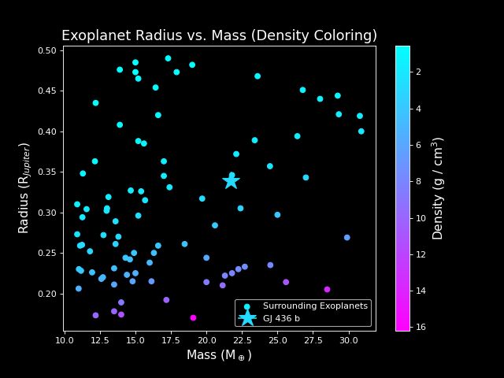

Slide 15
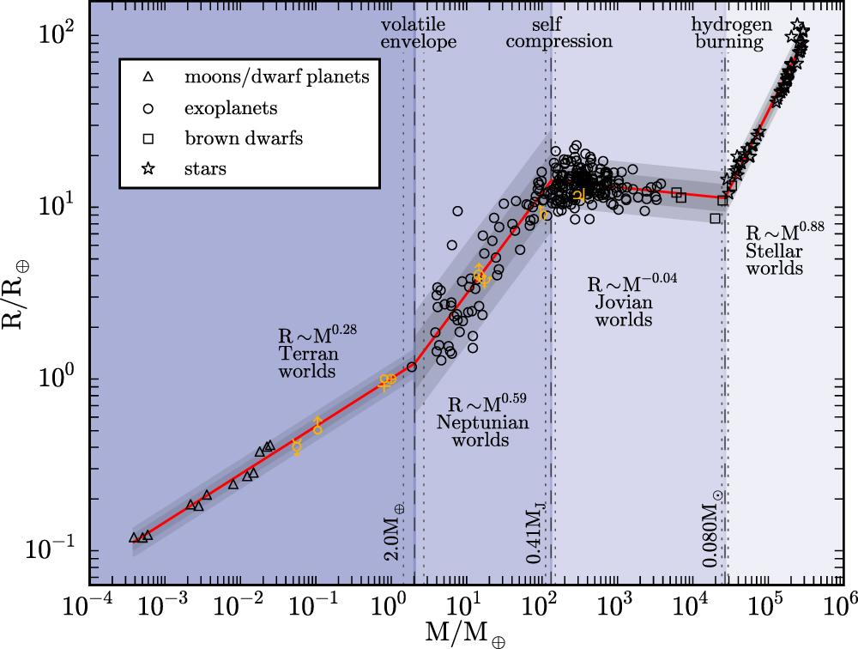
Results | Comparing to Chen & Kipping (2016)

Slide 16
Results | Comparing to Chen & Kipping (2016) (cont.)
Chen & Kipping model predicts radius of 0.561 ± 0.015 R_{Jupiter}
Our calculated value is 0.339 ± 0.024 R_{Jupiter}
The Chen & Kipping model reasonably agrees with our calculation
Difference likely comes from calculated radius

Slide 17
Conclusions
Our calculations of GJ 436 b’s mass and radius moderately agree with academic sources
Density is comparable to similar-size exoplanets
Chen & Kipping (2016) moderately agrees with our calculated mass and radius for GJ 436 b

